Slide 1
CT004-3.5-3
Advanced Database Systems
SQL Join Types

Slide 2
Topic & Structure of Lesson
Simple join
Three Tables join
Multigrouping columns
Left outer join
Right outer join
Full outer join

Slide 3
Learning Outcomes
By the end of this lesson you should be able to:
Use simple join to retrieve information from more than one table
Understand the different types of joins, INNER JOIN, LEFT OUTER JOIN, RIGHT OUTER JOIN
AND FULL OUTER JOIN.

Slide 4
Simple Join
List names of all clients who have viewed a property along with any comment supplied.
SELECT c.clientNo, fName, lName,
  propertyNo, comment
  FROM Client c, Viewing v
  WHERE c.clientNo = v.clientNo;

Slide 5
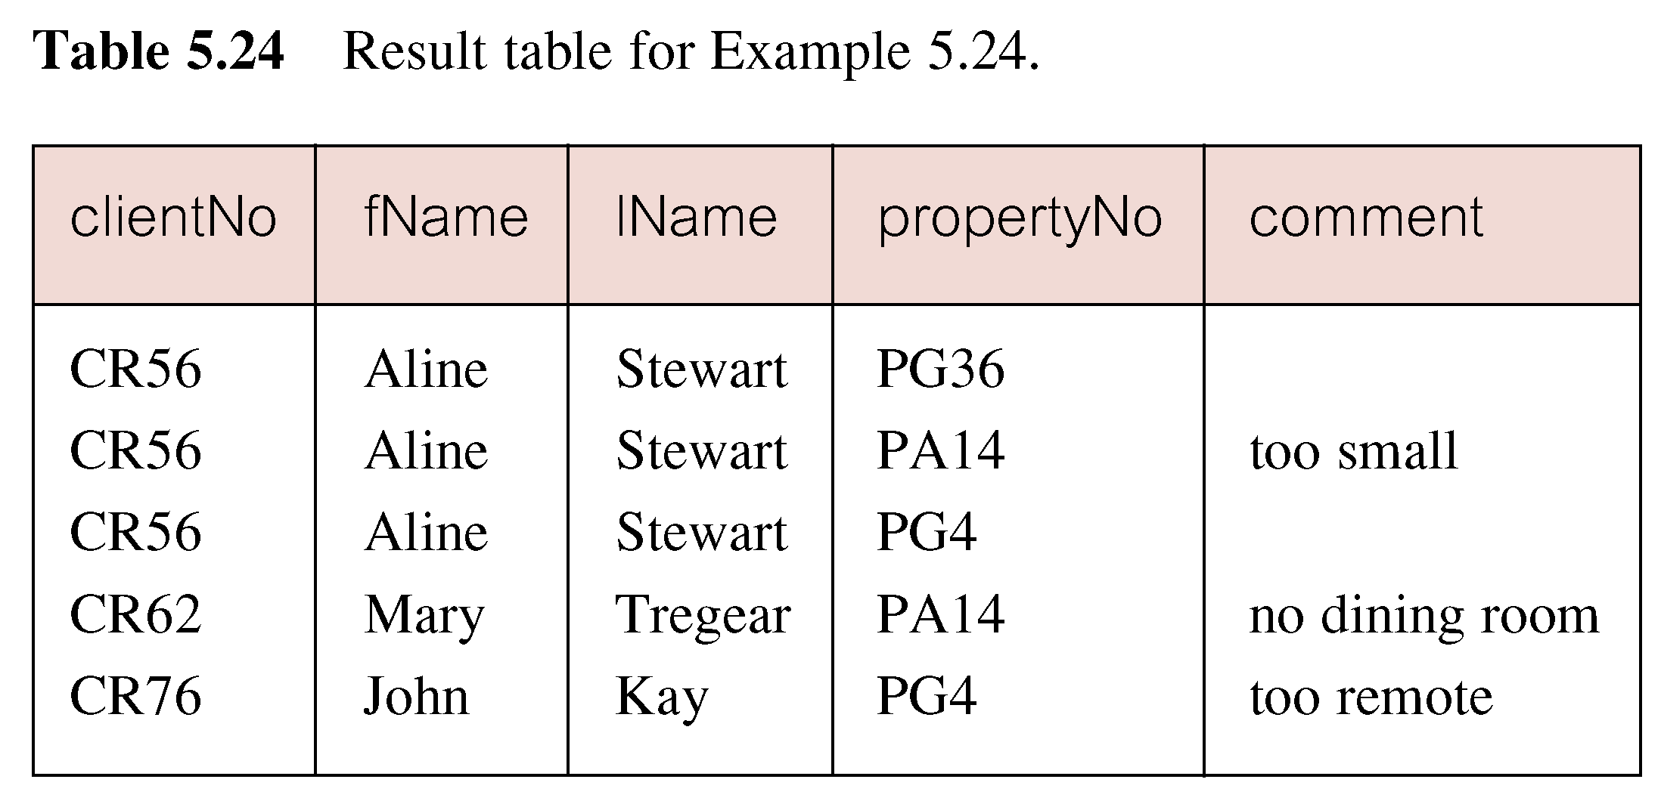
Simple Join
Only those rows from both tables that have identical values in the clientNo columns (c.clientNo = v.clientNo) are included in result.
Equivalent to equi-join in relational algebra.

Slide 6
Alternative JOIN Constructs
SQL provides alternative ways to specify joins:
FROM Client c JOIN Viewing v ON c.clientNo = v.clientNo
FROM Client JOIN Viewing USING clientNo
FROM Client NATURAL JOIN Viewing
In each case, FROM replaces original FROM and WHERE. However, first produces table with two identical clientNo columns.

Slide 7
Sorting a join
For each branch, list numbers and names of staff who manage properties, and properties they manage.
SELECT s.branchNo, s.staffNo, fName, lName,
  propertyNo
  FROM Staff s, PropertyForRent p
  WHERE s.staffNo = p.staffNo
  ORDER BY s.branchNo, s.staffNo, propertyNo;

Slide 8
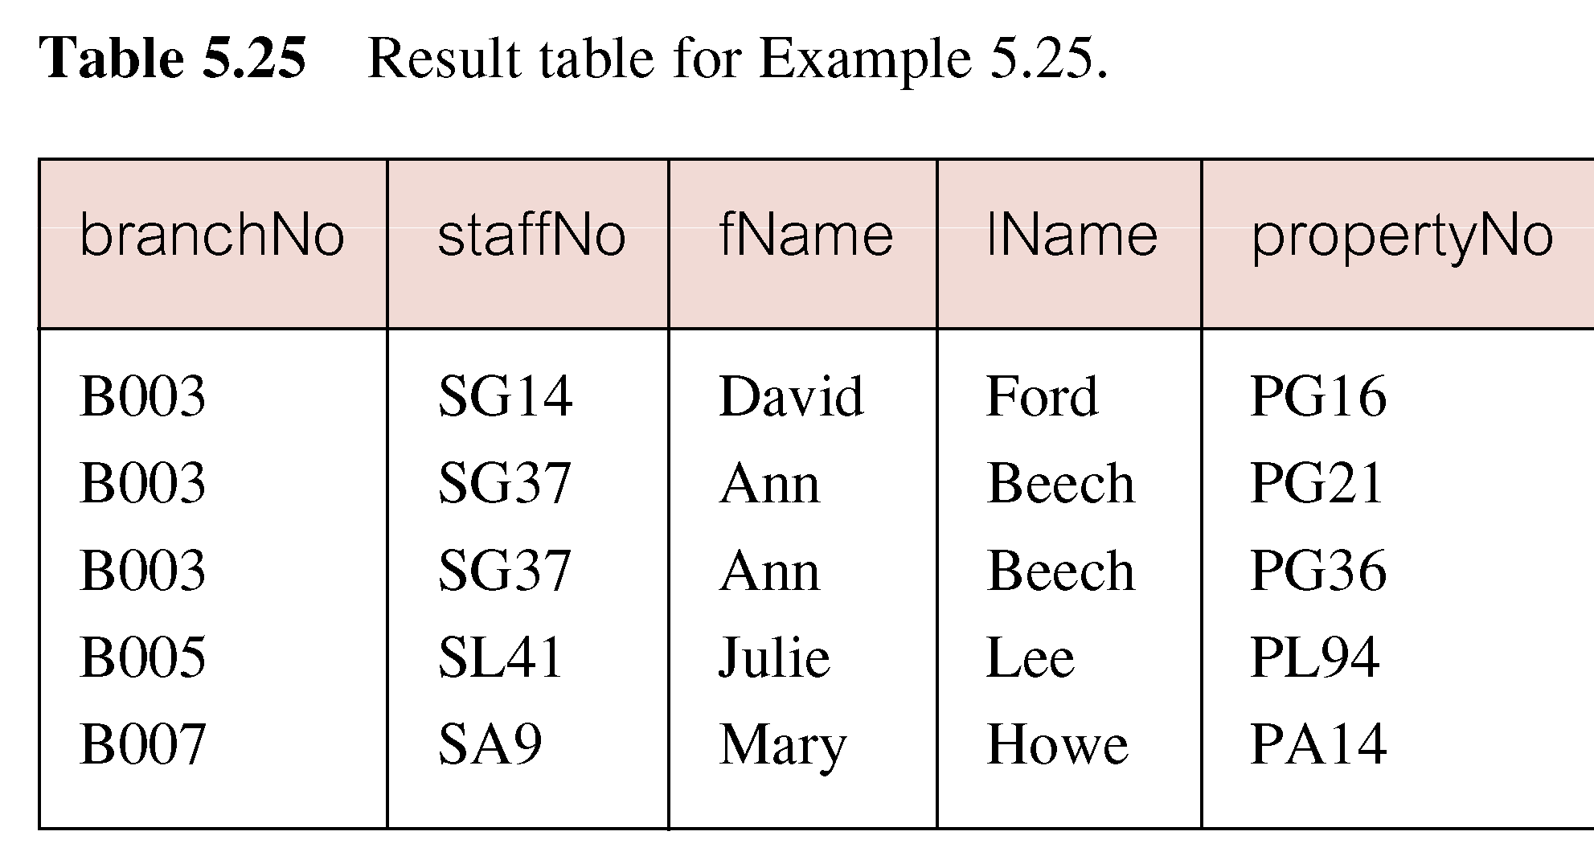
Sorting a join

Slide 9
Three Table Join
For each branch, list staff who manage properties, including city in which branch is located and properties they manage.
SELECT b.branchNo, b.city, s.staffNo, fName, lName, propertyNo
  FROM Branch b, Staff s, PropertyForRent p
  WHERE b.branchNo = s.branchNo AND
  s.staffNo = p.staffNo
  ORDER BY b.branchNo, s.staffNo, propertyNo;

Slide 10
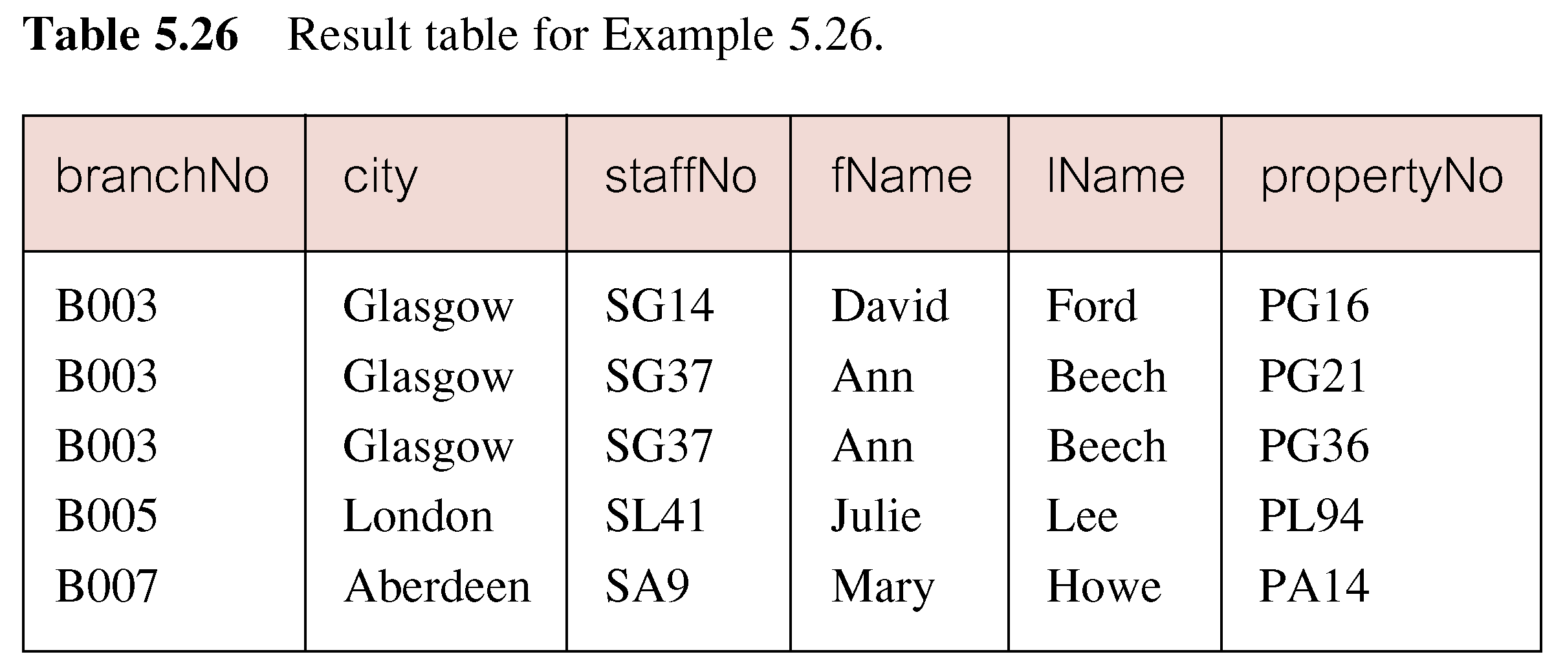
Three Table Join
Alternative formulation for FROM and WHERE:
  FROM (Branch b JOIN Staff s USING branchNo) AS bs JOIN PropertyForRent p USING staffNo

Slide 11
Multiple Grouping Columns
Find number of properties handled by each staff member.
SELECT s.branchNo, s.staffNo, COUNT(*) AS myCount
  FROM Staff s, PropertyForRent p
  WHERE s.staffNo = p.staffNo
  GROUP BY s.branchNo, s.staffNo
  ORDER BY s.branchNo, s.staffNo;

Slide 12
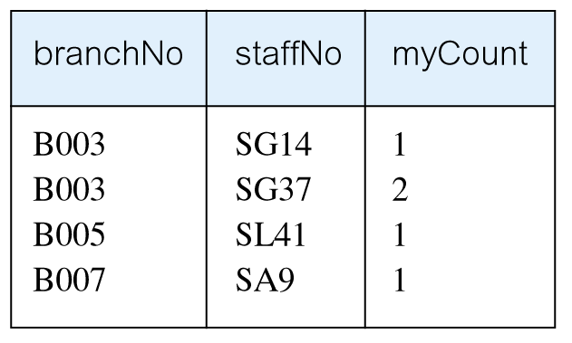
Multiple Grouping Columns

Slide 13
Computing a Join
Procedure for generating results of a join are:
1. Form Cartesian product of the tables named in FROM clause.
2. If there is a WHERE clause, apply the search condition to each row of the product table, retaining those rows that satisfy the condition.
3. For each remaining row, determine value of each item in SELECT list to produce a single row in result table.

Slide 14
Computing a Join
4. If DISTINCT has been specified, eliminate any duplicate rows from the result table.
5. If there is an ORDER BY clause, sort result table as required.
SQL provides special format of SELECT for Cartesian product:
  SELECT [DISTINCT | ALL] {* | columnList}
  FROM Table1 CROSS JOIN Table2

Slide 15
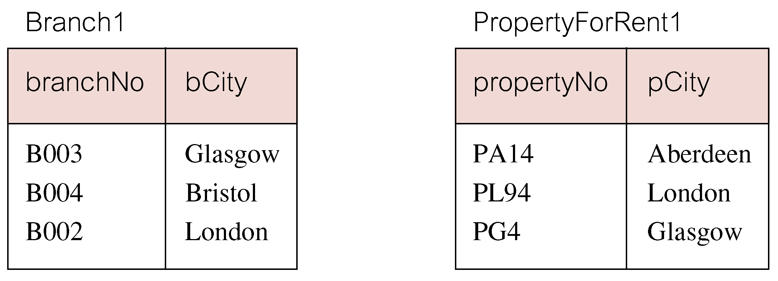
Outer Joins
If one row of a joined table is unmatched, row is omitted from result table.
Outer join operations retain rows that do not satisfy the join condition.
Consider following tables:

Slide 16
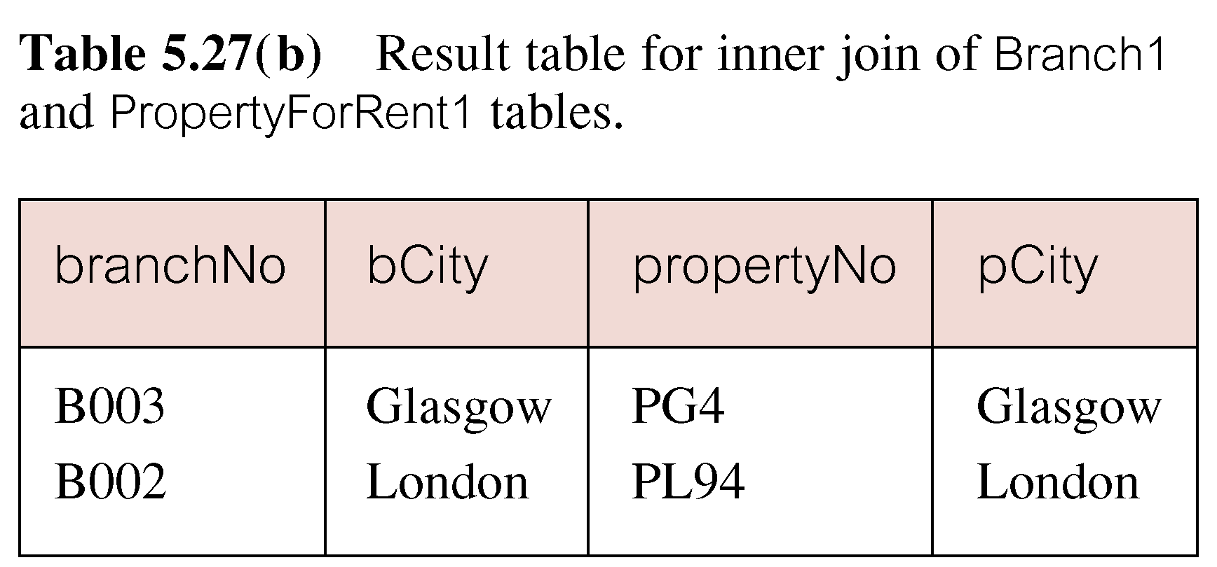
Outer Joins
The (inner) join of these two tables:
  SELECT b.*, p.*
    FROM Branch1 b, PropertyForRent1 p
    WHERE b.bCity = p.pCity;

Slide 17
Outer Joins
Result table has two rows where cities are same.
There are no rows corresponding to branches in Bristol and Aberdeen.
To include unmatched rows in result table, use an Outer join.

Slide 18
Left Outer Join
List branches and properties that are in same city along with any unmatched branches.
SELECT b.*, p.*
  FROM Branch1 b LEFT JOIN
  PropertyForRent1 p ON b.bCity = p.pCity;

Slide 19
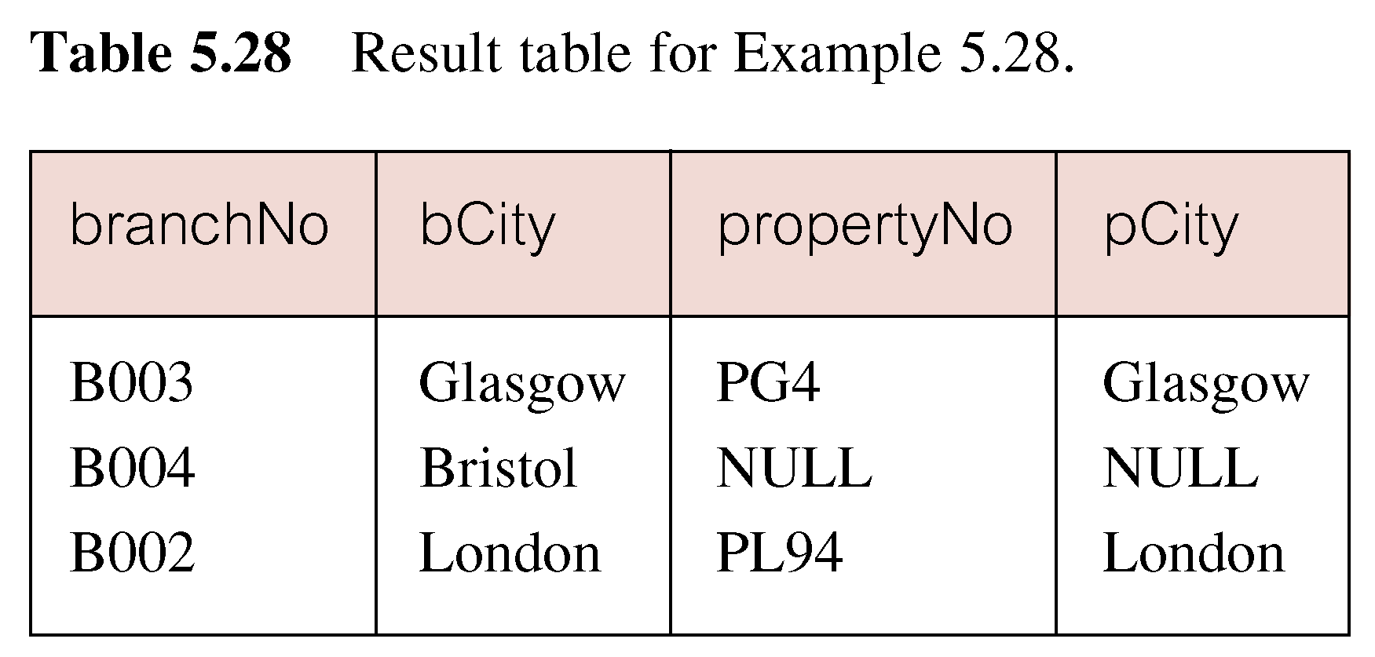
Left Outer Join
Includes those rows of first (left) table unmatched with rows from second (right) table.
Columns from second table are filled with NULLs.

Slide 20
Right Outer Join
List branches and properties in same city and any unmatched properties.
SELECT b.*, p.*
  FROM Branch1 b RIGHT JOIN
  PropertyForRent1 p ON b.bCity = p.pCity;

Slide 21
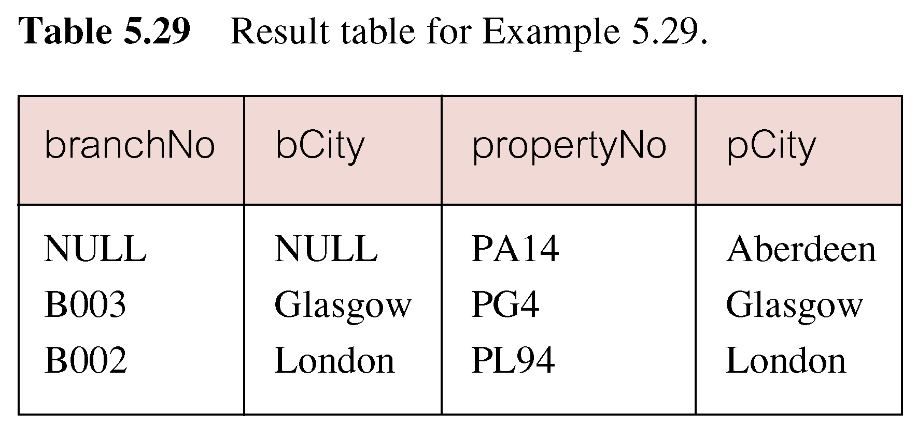
Right Outer Join
Right Outer join includes those rows of second (right) table that are unmatched with rows from first (left) table.
Columns from first table are filled with NULLs.

Slide 22
Full Outer Join
List branches and properties in same city and any unmatched branches or properties.
SELECT b.*, p.*
  FROM Branch1 b FULL JOIN
  PropertyForRent1 p ON b.bCity = p.pCity;

Slide 23
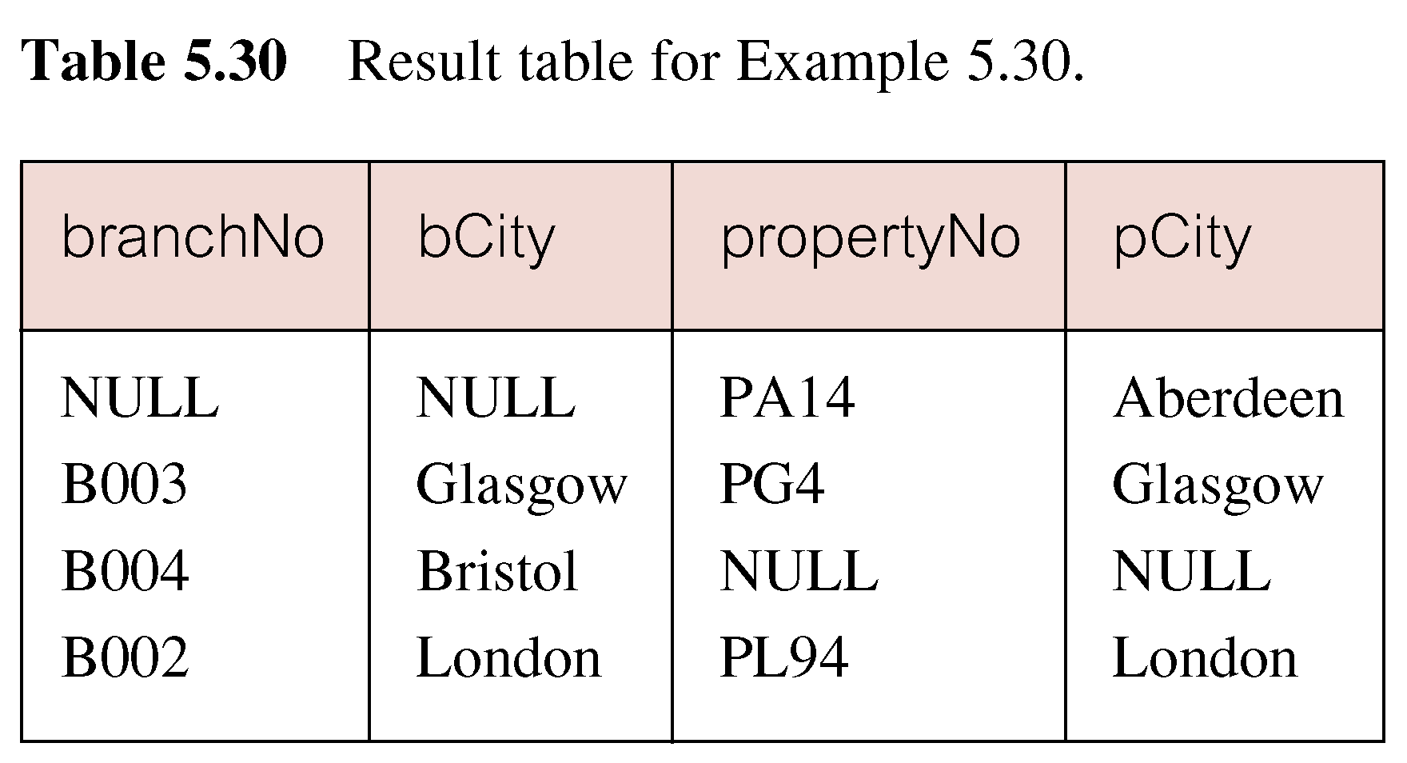
Full Outer Join
Includes rows that are unmatched in both tables.
Unmatched columns are filled with NULLs.

Slide 24
References
Connolly & Begg chapter 5 p. 140

